Slide 1
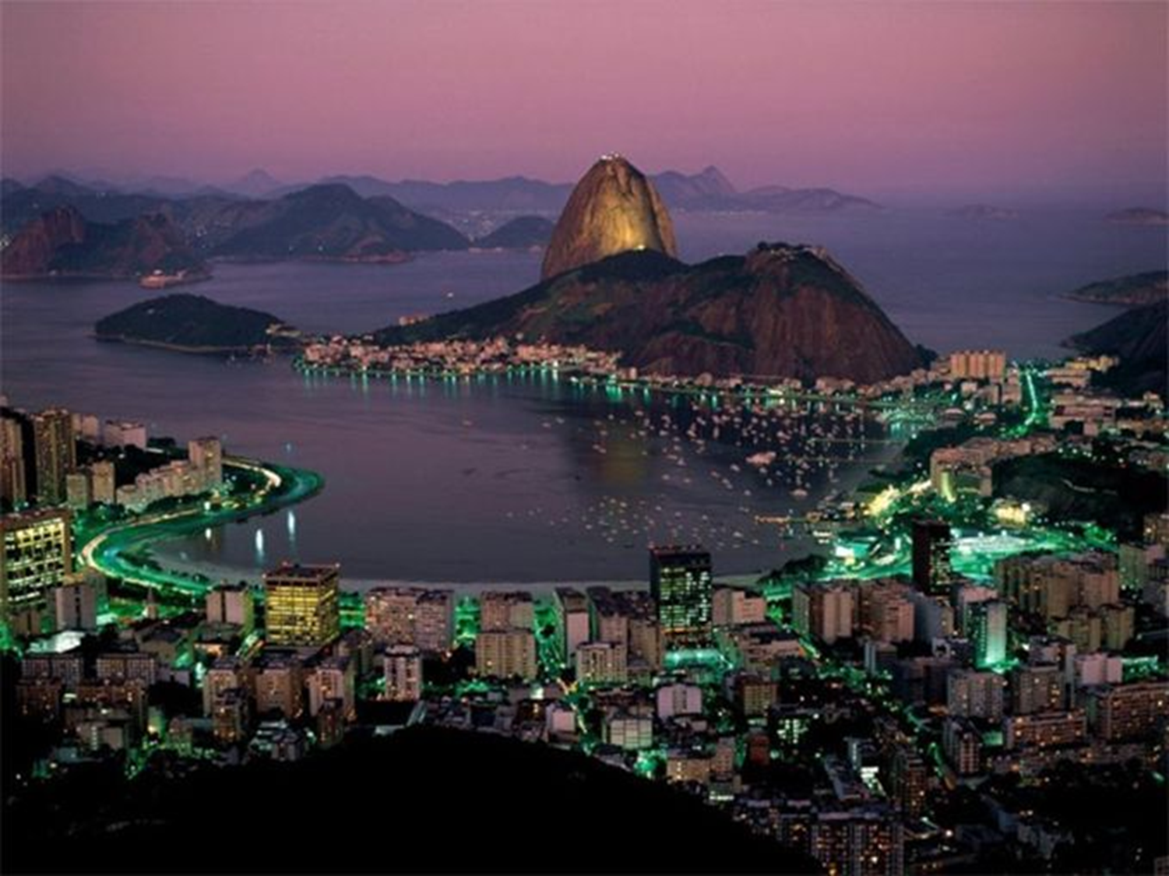
Brazil
Geography & Demographics

Slide 2
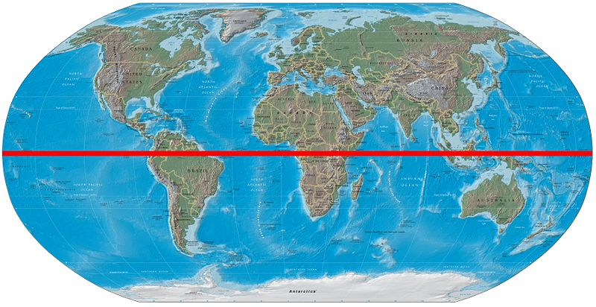
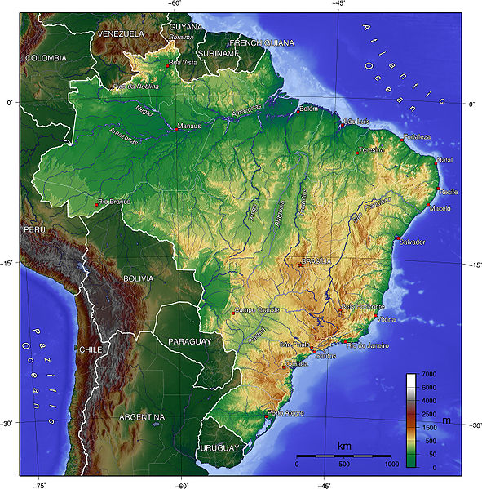
Location
Located in South America
On the equator
Includes most of the continent’s interior
Shares a border with all but two countries in South America
Uruguay, Argentina, Paraguay, Bolivia, Peru, Colombia, Venezuela, Suriname, Guyana, French Guiana

Slide 3
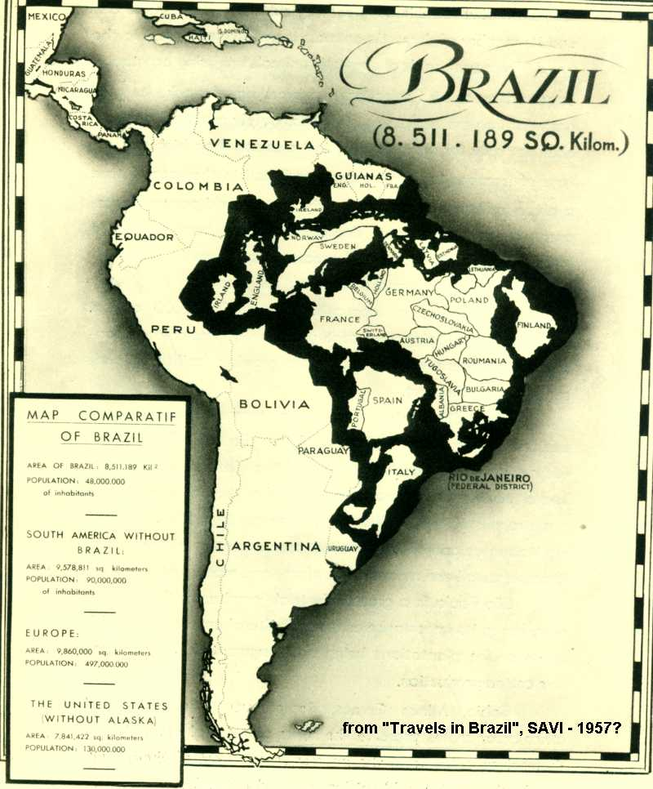
Size
Largest country in South America
Around half of the entire continent
Fourth largest country in the world by size
3,286,488 Sq. Miles

Slide 4
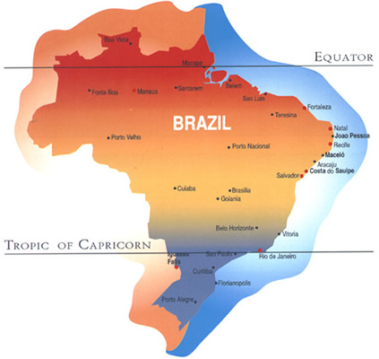
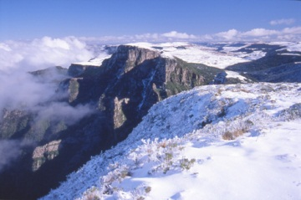
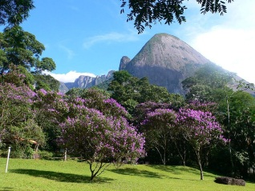
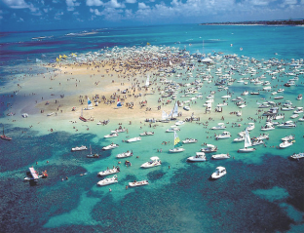
Climate—South America’s California
Five major climates
Equatorial
Tropical
Semiarid
Highland tropical
Temperate
Subtropical
North
Rainforests
Closest to the equator
No dry season
Central
Rainfall is seasonal
Tropical Savannas
Northeast
Semiarid Deserts
Rarely rains
South
Temperate climates
Temperate Coniferous Forests

Slide 5
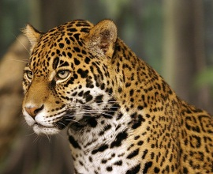
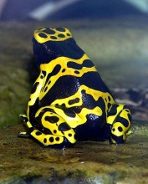
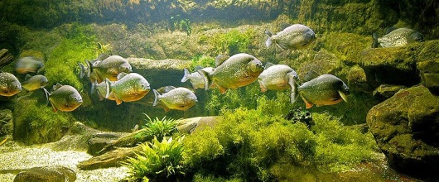
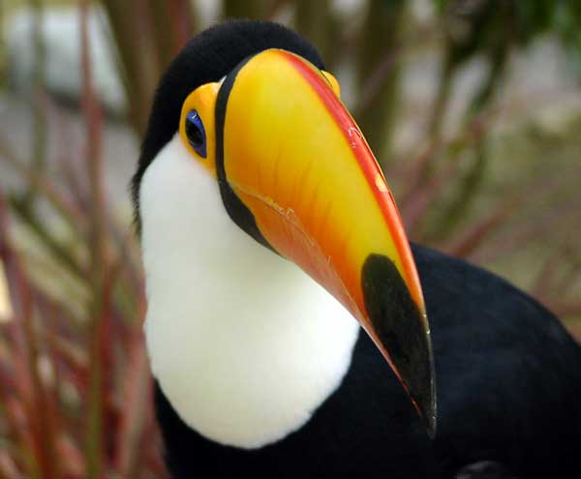
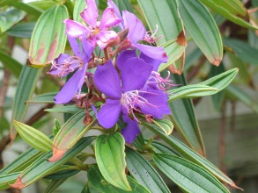
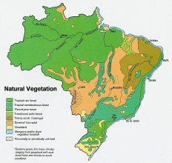
Biodiversity
Greatest biodiversity in the world
The Amazon Rainforest—1/10th of all species in the world
Almost four million total types of plants and animal species
Types of animals: maned wolf, bush dog, hoary foxes, jaguars, pumas, anteaters, sloths, anacondas, poison dart frogs, pink dolphins, penguins, Goliath Bird Eating Spiders

Slide 6
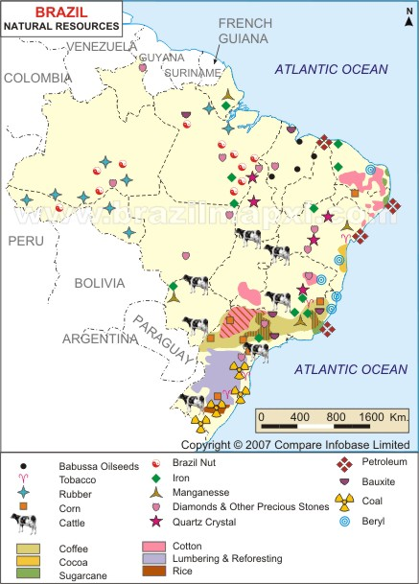
Natural Resources – A Competitive Advantage
Water
Brazil has 25% of the worlds fresh water
Oil
Big discoveries have led to a ton of investment
“By 2020, if all goes to plan, Petrobras and its foreign partners will be producing 5.7m barrels of oil and gas per day, more than half the output of Saudi Arabia”. (Economist, 2009)
Minerals
Iron Ore and Gold are most significant in terms of value of output
Copper, Zinc, Bauxite, Manganese also important

Slide 7
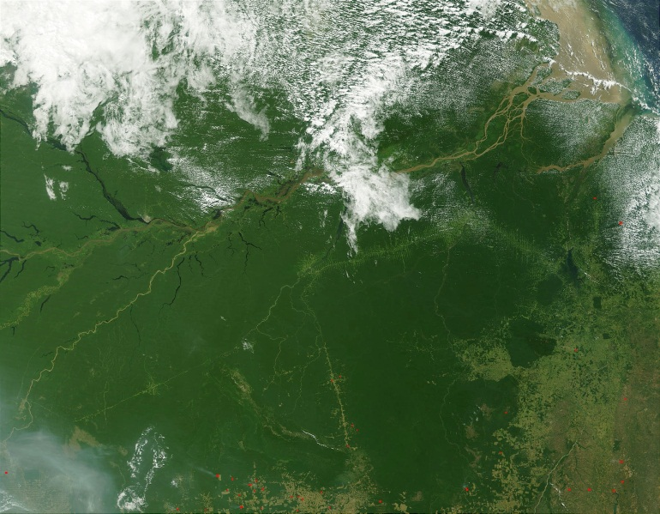
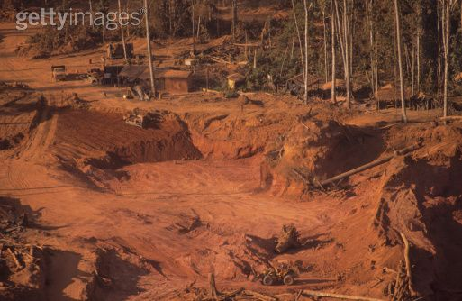
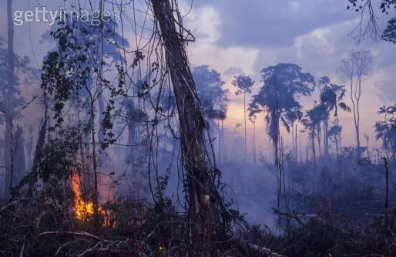
Environmental Issues – Rhetoric vs. Practice
Positive
Government has the goal to reduce greenhouse gas emissions by 38.9% by 2020
New policies to prevent deforestation are working
Negative
Deforestation remains a major concern
Deforestation of protected zones up 127% since 2000
Increased number of endangered species
Belo Monte dam controversy
Rapid Industrialization has resulted in more pollution
40% of fuel is ethanol based – different type of pollution

Slide 8
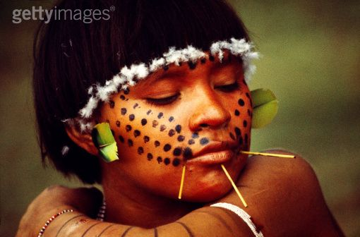
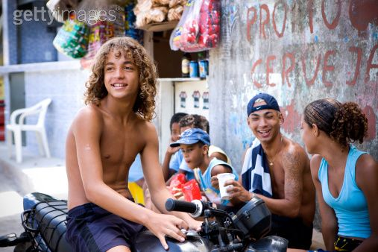
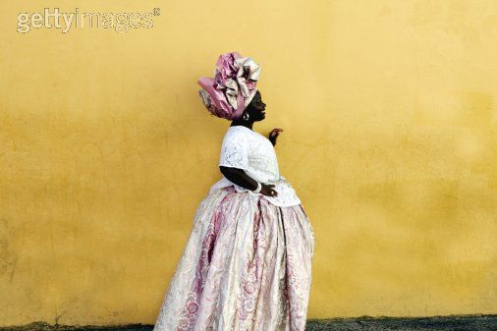
Racial Composition—A Story of Diversity
Aboriginal Brazilians (0.4%)
Found in the entire territory of Brazil, but most live on Indian reservations in the North and Centre-West
Over 60 Million Brazilians possess 1+ Amerindian ancestors, but consider “Indian” cultural, not racial
Black Brazilians (7.4%)
Asian Brazilians (1.1%)
Largest population of Japanese decent outside of Japan
Pardo Brazilians/multiracial (42.6%)
According to DNA resources, most Brazilians possess a mixed rate ancestry, but less than 45% identify as Pardo
White Brazilians (51.7%)
Soley descended from European immigrants, concentrated in the south and southeast regions

Slide 9
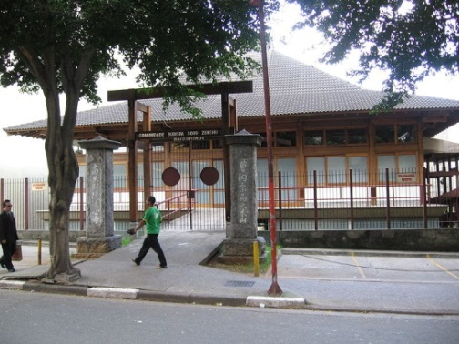
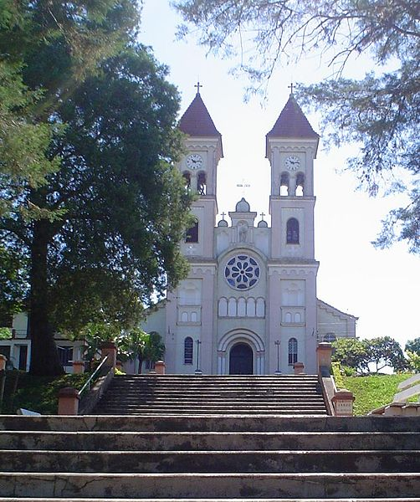
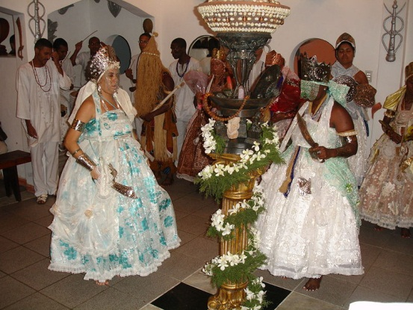
Religion—Unique Perspective
Roman Catholicism (68%)
Largest # of Roman Catholics in the world
Full of popular festivities influenced by popular Portuguese traditions
No religious affiliation (15.4%)
Protestantism (12.4%)
Spiritism (3.3%)
Afro-Brazilian religions, are concentrated in the Northeast large urban centers
Other religions (1.7%)
Many African, Spiritualist, and Folk religions incorporate original indigenous tradition
Buddhism is the largest of all minority religions because of Brazil’s large Japanese Brazilian community

Slide 10
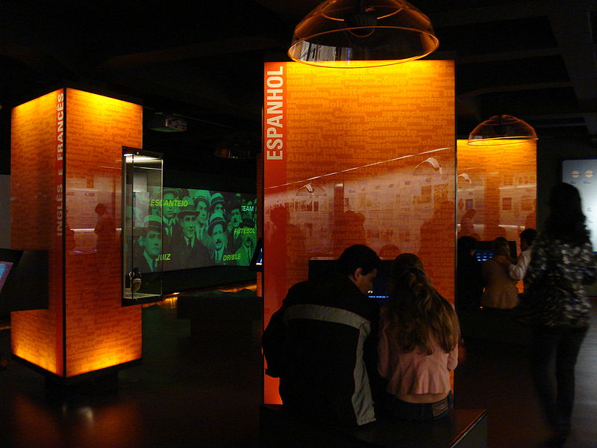
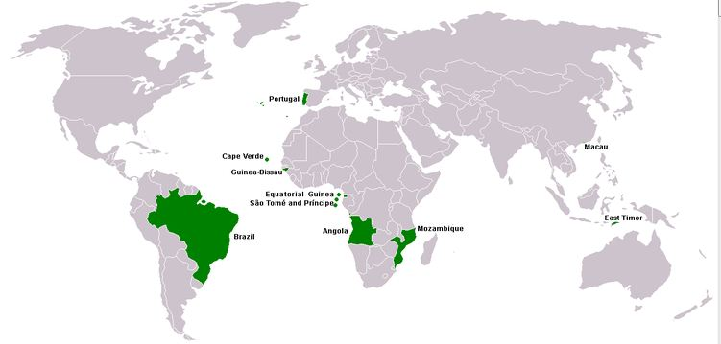
Portuguese Language— Fostering National Unity
11 dialects of Portuguese
Influenced by Amerindian and African languages, creating differences between Portuguese spoken in Brazil and that of other Portuguese speaking countries
This divide was heightened by introduction of words for technological innovations
210 minority languages are spoken in Brazil, including indigenous languages (80) and languages of more recent European and Asian immigrants

Slide 11
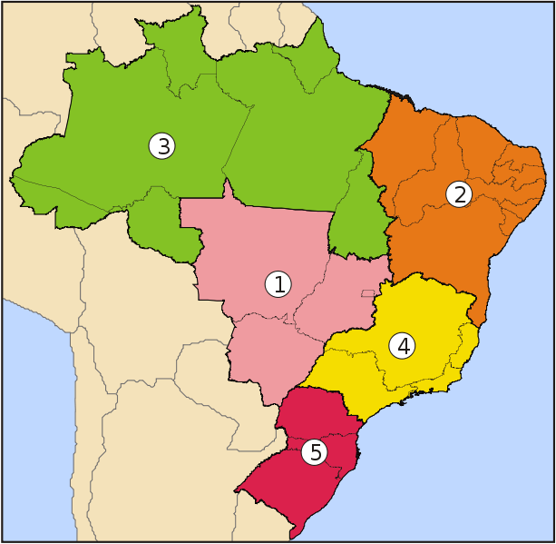
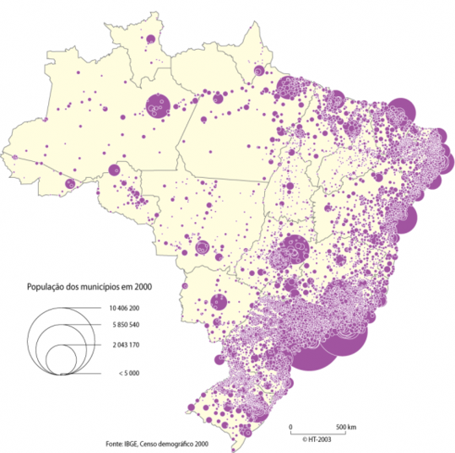
Regions/Largest Cities
Largest cities:
Sao Paulo: 11.3 million
Rio de Janeiro: 6.4 million
Salvador de Bahia: 2.7 million
Brasilia: 2.6 million
Fortaleza: 2.5 million
* 11 other cities with over 1.0 million
Regions:
Central-West: Home to the capital, Brasilia; otherwise low density
Northeast: Lowest living standards in Brazil; beautiful beaches, nonetheless
North: Home to the Amazon River and Rainforest
Southeast: Largest share of Brazil’s population with Sao Paulo and Rio de Janeiro
Southern: As densely populated as the Southeast, however mostly along the cost

Slide 12
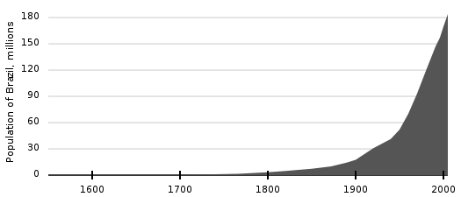
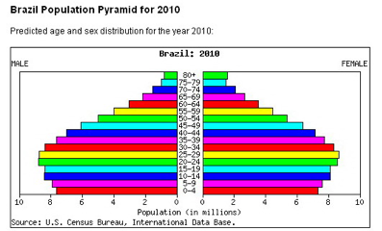
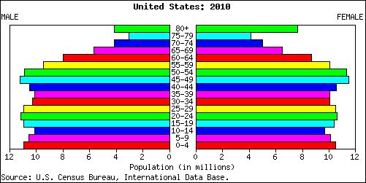
Population
Population
195,000,000 as of 2010 (World Bank)
5th largest country in the world
Almost exclusively concentrated near the coasts
Growing at 1%/year (CIA Factbook)
Age structure
0-14 years: 26.2% (male 27,219,651/female 26,180,040)
15-64 years: 67% (male 67,524,642/female 68,809,357)
65 years and over: 6.7% (male 5,796,433/female 7,899,650) (2011 est.)

Slide 13
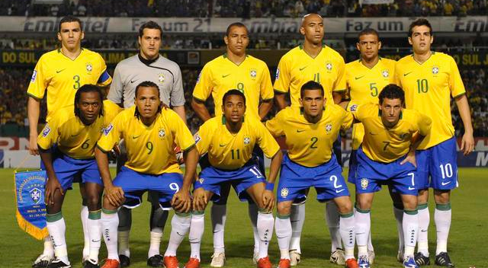
Gender Ratio— Looking Good for the MEN!
At birth: 1.05 male(s)/female
Under 15 years: 1.04 male(s)/female
15-64 years: 0.98 male(s)/female
65 years and over: 0.73 male(s)/female
Total population: 0.98 male(s)/female (2011 est.)

Slide 14
SLOTHS

