Slide 1
Business Environment

Slide 2
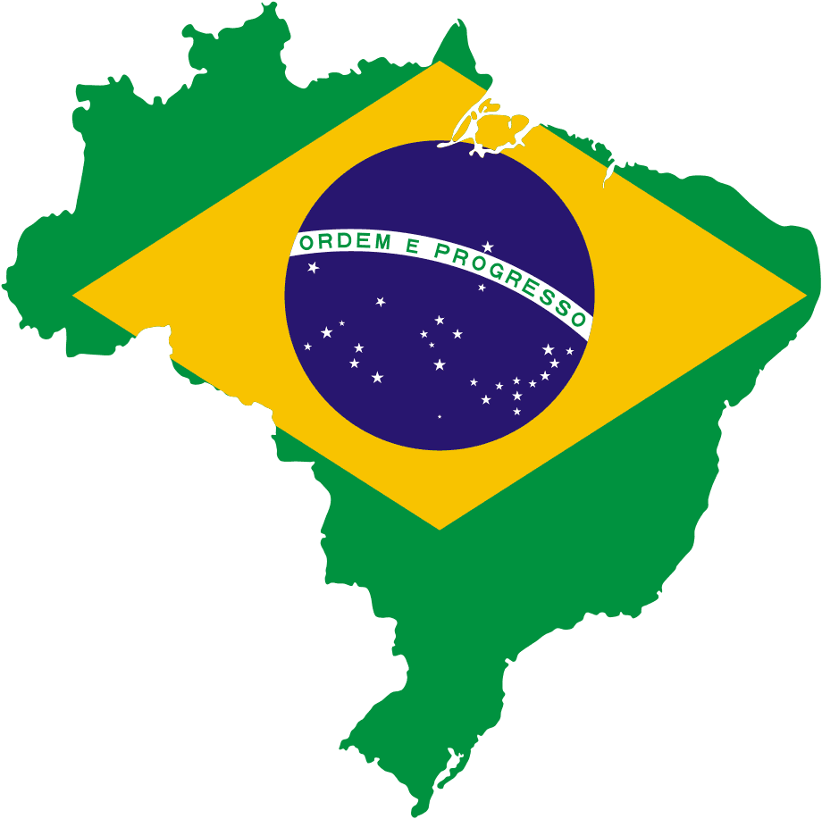
Brazil – Profile
8.511.965 sq km, slightly smaller than the China (9.596.961 sq km)
Population: 190.755.799 (5th largest in the world) Census 2010 IBGE
95.380.939 millions economically active (2009 - IPEA)
Population growth: 1,17%
GDP per capita (current US$) - $ 8.230,31 (2009 World Bank)
GDP: $ 1.594,49 billion (2009 World Bank – at current US$)
8th largest world economy

Slide 3
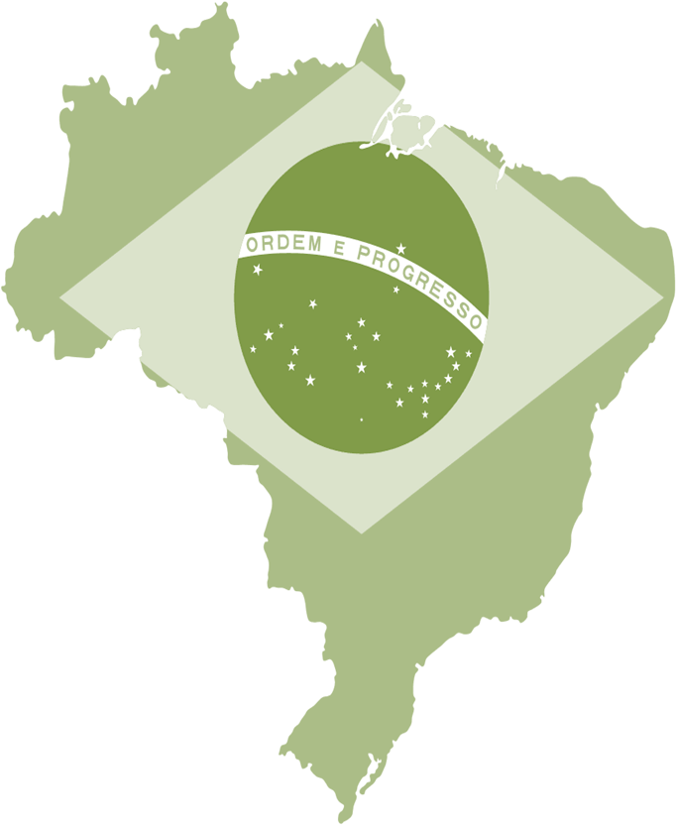
Trivia Question #1*
Where is it easier to start a business? Nigeria or Brazil?
*We’ve got prizes! : )

Slide 4
Trivia Question #1*
According to the “Ease of Starting a Business” rankings published by the World Bank…
Out of 183 countries, Brazil ranks 120. Nigeria ranks 116.

Slide 5
Global Rankings

Slide 6
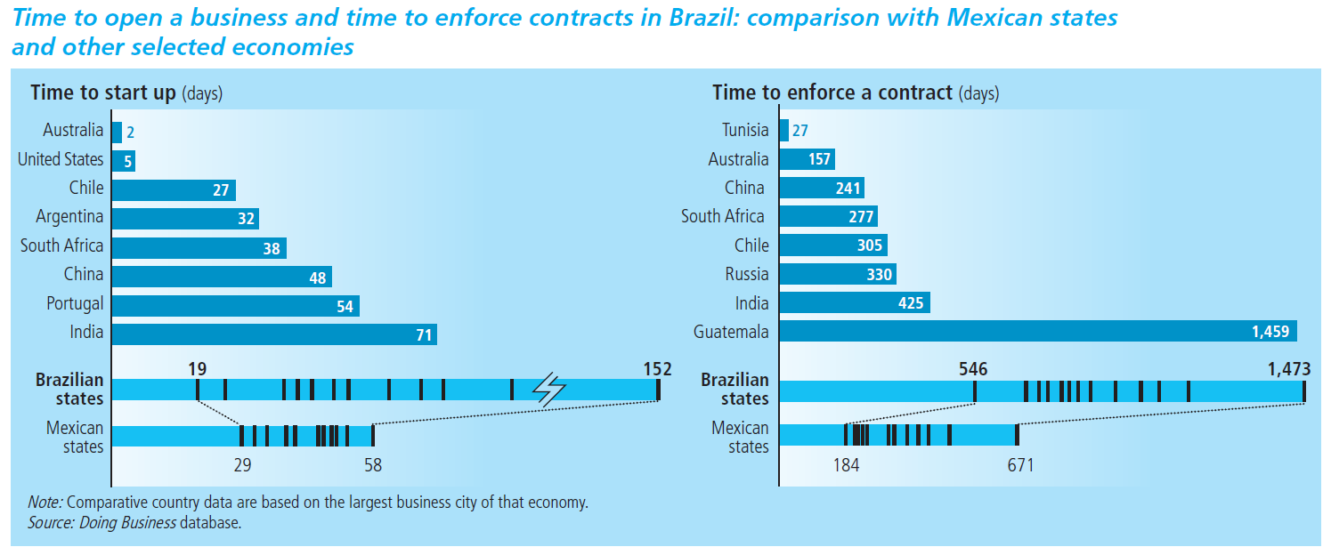
Time to open a business and time to enforce contracts in Brazil; comparison with Mexican states & other selected economies

Slide 7
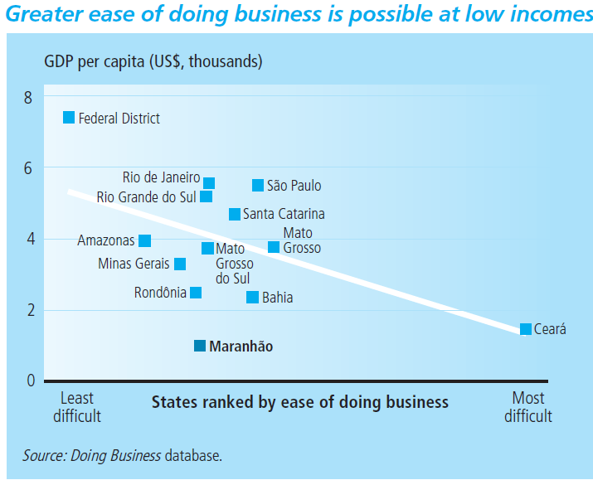
Ease of Doing Business

Slide 8
Trivia Question #2*
What is the “Custo Brasil” or “Brazil Cost?”
The average price of a Brazilian swimsuit
The cost of conversion to Brazilian Reals
The extra costs of doing business in Brazil including, but not limited to: governmental inefficiency, legal and bureaucratic complications, excessive taxation, poor infrastructure, and inflation

Slide 9
Top 10 Constraints to Firm Investment in Brazil (2009)
% of firms identifying problem as their greatest obstacle

Slide 10
Brazilian Tax Overview
Glance at $ome of the Taxes
Tax Acronym | COFINS | PIS | IPI | II | ICMS
Calculation Base | Gross Revenues | Gross Revenues | Industrialized Products Sold | Value of Imported Product/Service | Value of Merchandise
Subject Liable | Corporate Entity | Corporate Entity | Corporate Entity | Individual or Corporate Entity | Corporate Entity
Rates | 7.6% | 1.65% | 0% - 365% | 0% - 35% | 4% - 25%

Slide 11
Trivia Question #3*
So…given all the challenges, why do business in Brazil?

Slide 12
Agribusiness to Brazil
“Brazil is to agriculture what India is to business offshoring and China to manufacturing: a powerhouse whose size and efficiency few competitors can match.”
Alan Beattie, Financial Times

Slide 13
Brazil Rank – Agribusiness Production and Exports - 2009
Main Products | Production | Exports | # of Markets | Exports Value US$ Billion
Sugar | 1st | 1st | 124 | 8.378
Coffee | 1st | 1st | 81 | 3.762
Orange Juice | 1st | 1st | 75 | 1.619
Soybean | 2nd | 2nd | 46 | 11.413
Beef | 2nd | 1st | 142 | 4.118
Tobacco | 2nd | 1st | 100 | 2.992
Ethanol | 2nd | 1st | 48 | 1.338
Broiler | 3rd | 1st | 146 | 5.307
Corn | 4th | 3rd | 49 | 1.259
Pork | 4th | 4th | 81 | 1.225

Slide 14
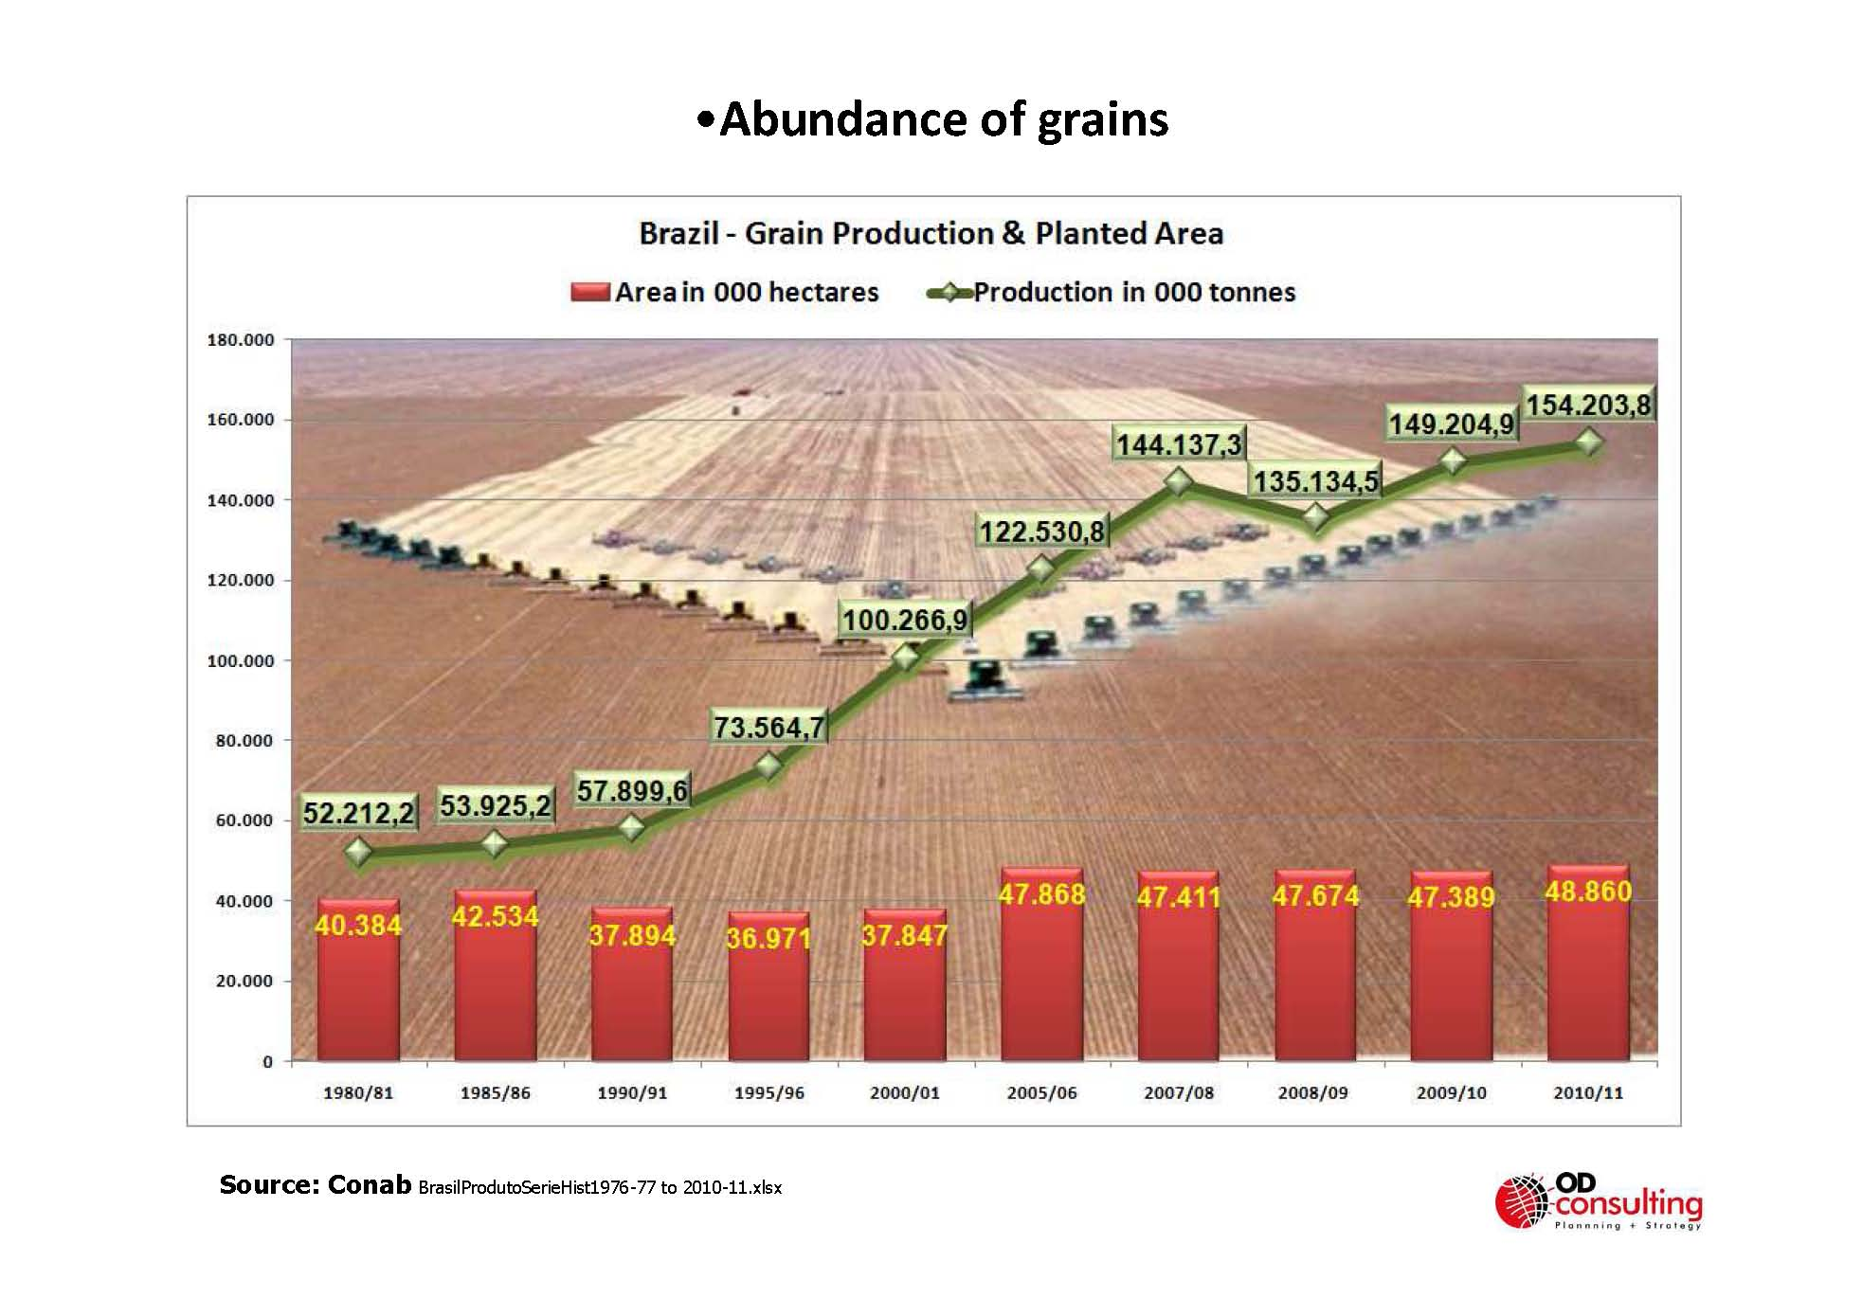
Abundance of Grains Brazil – Grain Production & Planted Area
Source: Conab BrasilProdutoSerieHist1976-77 to 2010-11.xlsx

Slide 15
Trivia Question #3
“Forecasts vary, but…Brazil is likely to become the world’s fifth-largest economy. And in some ways, Brazil outclasses the other BRICs.
Unlike China, it is a democracy. Unlike India, it has no insurgents, no ethnic and religious conflicts nor hostile neighbors. Unlike Russia, it exports more than oil and arms, and treats foreign investors with respect.
Indeed, when it comes to smart social policy and boosting consumption at home, the developing world has much more to learn from Brazil than from China.”
Source: The Economist, “Brazil Takes Off,” Nov 12, 2009.

Slide 16
Brazil has built its international reserves thanks to the agribusiness exports

Slide 17
Brazilian Regions

