Slide 1
Global Trip – Brazil
US and Multi-National Corporations Doing Business In Brazil
Relevant Industries / Corporations
Jeopardy
February 1, 2012

Slide 2
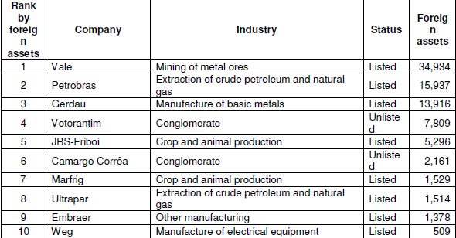
Brazilian Multinationals: Positive after the global crisis
The internationalization of Brazilian companies is a relatively recent phenomenon:
From 2000 to 2003, outward FDI from Brazil averaged less than USD 1billion a year.
Over the four-year period 2004−2008, this average jumped to nearly USD 14 billion

Slide 3
Brazil’s Aerospace Industry
World-class leader; fifth largest market in the world with sales of over $16 billion
Embraer, based in São Paolo, is the world’s fourth largest commercial aircraft company behind:
Airbus SAS
Boeing Co.
Bombardier, Inc.
The country is a major importer of aircraft parts and generated $1.6 billion between January and August 2008 alone:
Growth of airline passenger traffic is creating need for airport management services
Potential in space sector for satellite equipment, ground support systems and consulting
Source: JPMorgan Chase & Co. “The Economic Ascendancy of Brazil: What It Means for U.S. Companies” - 2010
Notes:
Brazil's Aviation Industry: Set For Take-Off
Latin American air travel is expected to grow by approximately 70% over the next two decades,
Driven by an above avg. economic growth rate of approximately 4% per year.
“Much of the growth in Latin America will take place in Brazil as the region’s largest aviation market,” predicts Randy Tinseth, vice president of Marketing for Boeing Commercial Airplanes
“Brazil has seen a near-50% increase in the number of jet aircraft in the last 10 years and there are no signs of slowing over the next 20 years, due to:
Strong economy
Growing middle class,
More access to air travel due to the introduction of the low-cost carrier model

Slide 4
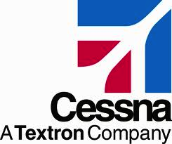
Aviation Industry Overview
Original Equipment Manufacturers (OEMs): commercial, executive, and military

Slide 5
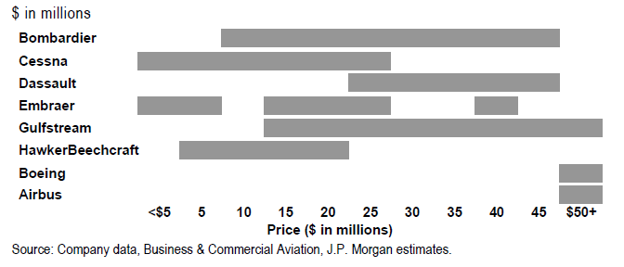
Textron Profile
Textron Inc. operates in five segments: Cessna, Bell, Textron Systems, Industrial, and Finance
Cessna has delivered approximately 192,000 aircraft, including more than 154,000 single engine airplanes; more than 1,900 Caravans; more than 2,000 military jets and more than 6,000 Citation business jets. Cessna has delivered 52% more business jets than its closest competitor
One-third of the world’s operating vertical lift aircraft are made by Bell, including advanced military aircraft and a variety of commercial single- and twin-engine helicopters..
Business Jet Product and Pricing Span by Company:

Slide 6
Oil and Gas Industry in Brazil
ExxonMobil
Has drilled three deep water wells off the coast of Brazil (in the Santos Basin) and not found oil
Exxon holds 40% interest and is operator, Hess owns 40% stake and Petrobras holds 20% stake
In years past, Exxon described exploration in Brazil as “high-potential”
PetroBras
Has made discoveries of multibillion barrels of oil in recent years near where Exxon has drilled
Owns 20% stake in Exxon’s deep water wells off the coast of Brazil
As of yesterday (1/31), PetroBras reported an accident at an ultra-deepwater oil field off Brazil’s coast spilled an estimated 160 barrels of crude into the Atlantic Ocean

Slide 7
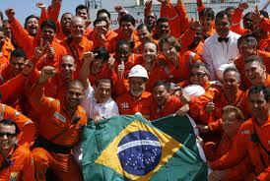
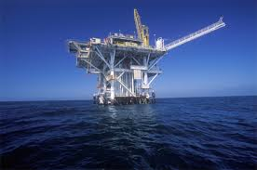
Oil and Gas Industry in Brazil
Scope
Brazil is expected to become a major oil exporter and is building dozens of drilling rigs and support ships to support the extraction of the oil
Brazil is expected to pass the US Gulf of Mexico in offshore oil production in less than 5 years.

Slide 8
GE Sponsors 2016 Olympics in Rio de Janeiro
Olympics is prime market to showcase innovation
Plans on opening fifth global research center in Rio
$100 million is to be invested toward center- largely focused in oil & gas and renewable energy
Will eventually employ 200 people
Looking to deliver sustainability to the Olympic Games
Rio de Janeiro draws infrastructure projects
GE views sponsorship as an opportunity to expand local infrastructure
GE businesses have seen nearly a 30% growth in Brazil
Primary focus is in “healthcare equipment, trains, wind turbines and industrial equipment”

Slide 9
Multi-National Financial Institutions in Brazil
Accounting Standard Convergence
Overview
As of the end of 2010, Brazil will have substantially converged its accounting standards (BR GAAP) with IFRS
Listed companies, certain regulated financial institutions now required to publish consolidated financial statements in accordance with IFRS
Result of efforts of IASB, CFC, CPC, CVM to eliminate significant differences between BR GAAP and IFRS; reinforce Brazil´s commitment to achieving BR GAAP and IFRS synergy
Ramifications to Multi-Nationals
Expected to affect all Brazilian legal entities, including Brazilian subsidiaries of U.S. multinational companies, whether or not they are required to publish audited financial statements for statutory reporting purposes
Potential challenges include complications that the U.S. parent company may face if the Brazilian subsidiary makes accounting policy decisions unilaterally
Monetary Exchange
Rise against the Dollar since 2003
US Dollar – Brazilian Real Exchange Rate
1 USD = 1.75 BRL (keep exchange receipt to change back when you leave)
R$

Slide 10
Multi-National Financial Institutions in Brazil
R$
Brazilian Government Efforts to Slow Overheating Economy
Central Bank tighten monetary policy
Implementation of capital controls to restrict credit growth
Despite This…
Multinational Financial Institution Expansion
JP Morgan
Plans to almost double its headcount in Brazil
High-profile acquisition of Rio based hedge fund Gavea Investimentos
BNP Paribas
Added 400 – 500 personnel in Brazil to bring total headcount to ~2,500
Expanding into new areas like establishment of a securities brokerage
Industrial and Commercial Bank of China
World’s biggest lender by market cap
Plans to open branch in Sao Paulo

Slide 11
Jeopardy
Olympic Growth
Plane
Cents
Language /
Trivia
Oil and Gas
$100
$100
$100
$100
$200
$200
$200
$200
$300
$300
$300
$300
$400
$400
$400
$400

Slide 12
$100 Question from Oil and Gas
The number of oil wells
Exxon has drilled off the
Brazilian coast

Slide 13
$100 Answer from Oil and Gas
3

Slide 14
$200 Question from Oil and Gas
The company that recently
had an oil spill off the
Brazilian Coast

Slide 15
$200 Answer from Oil and Gas
Petrobras

Slide 16
$300 Question from Oil and Gas
The amount of stake Petrobras
has in Exxon's deep water well

Slide 17
$300 Answer from Oil and Gas
20%

Slide 18
$400 Question from Oil and Gas
The largest foreign owner of
exploration rights in the
Santos, Campos, and
Espíritu Santo basins

Slide 19
$400 Answer from Oil and Gas
Repsol Sinopec Brazil
(Spain, China, Brazil JV)

Slide 20
$100 Question from Olympic Growth
The company that is looking
to deliver sustainability to
the Olympic Games

Slide 21
$100 Answer from Olympic Growth
GE

Slide 22
$200 Question from Olympic Growth
The percentage growth GE's
companies have seen in Brazil

Slide 23
$200 Answer from Olympic Growth
30%

Slide 24
$300 Question from Olympic Growth
The number of people the
GE Global Research Center
in Rio will employ

Slide 25
$300 Answer from Olympic Growth
200

Slide 26
$400 Question from Olympic Growth
The 3 events in which Brazil
competed in the 2010 Winter
Olympic Games

Slide 27
$400 Answer from Olympic Growth
Alpine Skiing,
Cross-Country Skiing,
Snowboarding

Slide 28
$100 Question from Plane Cents
Exchange Rate – USD to BRL

Slide 29
$100 Answer from Plane Cents
1 USD = 1.75 BRL

Slide 30
$200 Question from Plane Cents
Fastest civil aircraft
currently in production

Slide 31
$200 Answer from Plane Cents
Cessna Citation X

Slide 32
$300 Question from Plane Cents
3 competitors in the aviation industry

Slide 33
$300 Answer from Plane Cents
Airbus, Boeing,
Cessna, Dassault Falcon…

Slide 34
$400 Question from Plane Cents
Itau Unibanco’s rank on
world’s largest banks
(by market cap as of 2011)

Slide 35
$400 Answer from Plane Cents
11th

Slide 36
$100 Question from Language / Trivia
The country that is hosting
the 2014 World Cup and
2016 Olympic Games

Slide 37
$100 Answer from Language / Trivia
What is Brasil

Slide 38
$200 Question from Language / Trivia
‘Thank You’ in Portuguese

Slide 39
$200 Answer from Language / Trivia
Obrigado / Obrigada

Slide 40
$300 Question from Language / Trivia
‘All is well’ in Brazilian Portuguese

Slide 41
$300 Answer from Language / Trivia
Tudo Bem

Slide 42
$400 Question from Language / Trivia
How to order a beer in Brazil

Slide 43
$400 Answer from Language / Trivia
Uma cerveja, por favor

