Slide 1
Item Search

Slide 2
Cross classification of rules
Noncompensatory: Select set or item with particular characteristic: Camry
  Also: Eliminate set or item without a particular characteristic: nonCamrys
Compensatory: Weighed function of attributes: Camry versus Corolla
  Size, gas mileage, cost

Slide 3
Sequence of Rules
Efficiency: number of observations/set
  Set Rules: One observation per set
  One-by-one rules: One observation per member of set

Slide 4
Markets are organized to facilitate set rules
Store or site
  Specializes
  Departments
  Close substitutes grouped together
Example: Car delearship say Toyota
Camrys, Torolas grouped together
Row of Camrys must look at each car

Slide 5
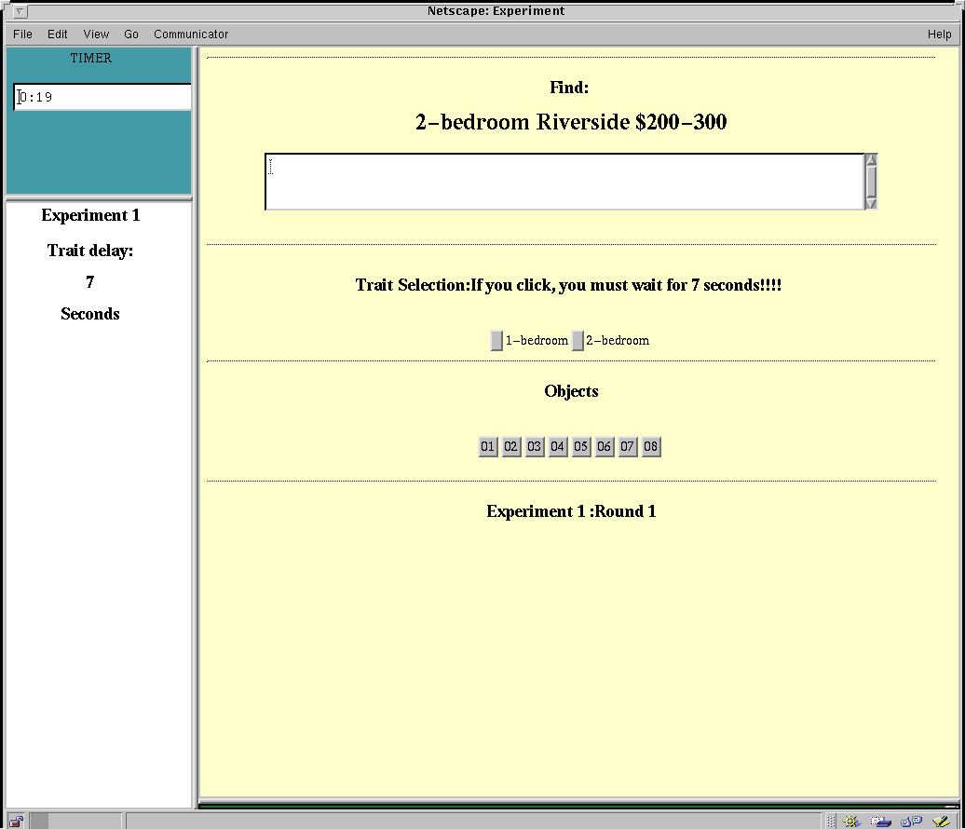

Slide 6
